Slide 1


Y6 SATS 2026

Slide 2


What do you know about SATs?
Please complete the SATs quiz – this can be done individually or with others.
©Ks2history 2018

Slide 3
What are SATs?
● SATs are Standardised Assessment Tests that are given to children at the end of
Key Stage 2.
● The SATs take place over four days. This year they start on Monday 11th May and end on Thursday14th May2026.
● The SATs papers consist of:
○ Grammar, punctuation and spelling (paper 1: GPS) – Monday 11th May
○ Grammar, punctuation and spelling (paper 2: Spelling) – Monday 11th May
○ Reading – Tuesday 12th May
○ Maths (paper 1: Arithmetic) – Wednesday 13th May
○ Maths (paper 2: Reasoning) – Wednesday 13th May
○ Maths (paper 3: Reasoning) – Thursday 14th May
● Writing is assessed using evidence collected throughout Year 6. There is no Year 6
SATs writing test.
The key stage 2 tests will be taken on set dates unless your child is absent, in which case they may be able to take them up to 5 school
days afterwards.
©Ks2history 2018

Slide 4
When and how the SATs are completed?
● The tests take place during normal school hours under exam conditions.
● Children are not allowed to talk to each other from the moment the assessments are
handed out until they are collected at the end of the test.
● After the tests are completed, the papers are sent away to be marked externally.
● The results are then sent to the school in July.
● Each test lasts no longer than 60 minutes:
○ Spelling, punctuation and grammar (paper 1: Grammar/ Punctuation) – 45 minutes
○ Spelling, punctuation and grammar (paper 2: Spelling) – 15 minutes
○ Reading – 60 minutes
○ Maths (paper 1: Arithmetic) – 30 minutes
○ Maths (paper 2: Reasoning) – 40 minutes
○ Maths (paper 3: Reasoning) – 40 minutes
©Ks2history 2018

Slide 5
Specific arrangements for SATs
Children with additional needs (who have similar support as part of day-to-day learning in school) may be allotted specific arrangements, including:
● Additional (extra) time;
● Tests being opened early to be modified;
● An adult to scribe (write) for them;
● Using word processors independently;
● An adult to read for them ;
● The use of prompts or rest breaks;
● Arrangements for children who are ill or injured at the time of the tests.
©Ks2history 2018

Slide 6
How are the tests graded?
The marked tests will provide the following information: - A raw score (total number of marks achieved for each paper); - A scaled score (see below) - An indication of whether the national standard has been met.
After each test is marked, it is converted into a scaled score and that will show whether a pupil is working at the national standard, above or below it.
In scaled scores, a score of 100 represents the national standard. The lowest is 80 and the highest is 120.
A scaled score > 110 shows that a child is working at the higher standard/ greater depth.

Slide 7
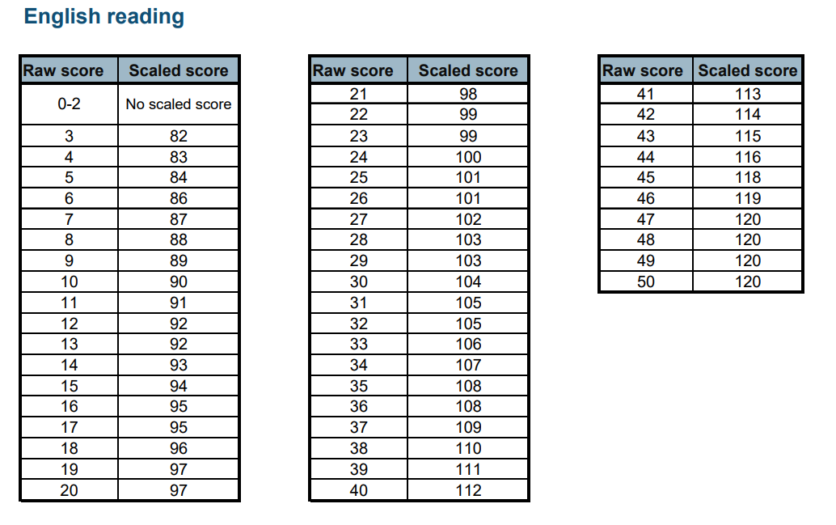
Example of raw score conversions
©Ks2history 2018

Slide 8
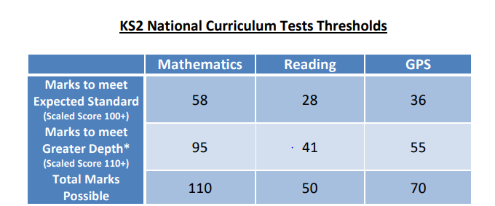
Example of test thresholds
©Ks2history 2018

Slide 9
The SPAG Test
There are two tests: a short spelling test and a longer paper testing grammar, punctuation and vocabulary.
The spelling test lasts approximately 15 minutes and pupils will need to spell words in context by filling in the gaps in sentences.
The grammar, punctuation and vocabulary test lasts for 45 minutes.
Pupils need a good working knowledge of technical vocabulary used to describe grammatical terms and punctuation marks.
Questions in the grammar test are focused around the following areas (called ‘content domains’): - Grammatical terms/word classes - Functions of sentences - Combining words, phrases and clauses - Verb forms, tenses and consistency - Punctuation - Vocabulary - Standard English and formality
There are a range of answer types in the grammar test, including multiple choice and short one-word answers, but there will not be any long written answers required

Slide 10
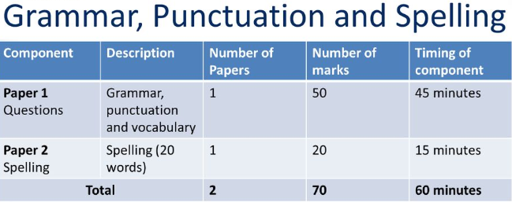
©Ks2history 2018

Slide 11
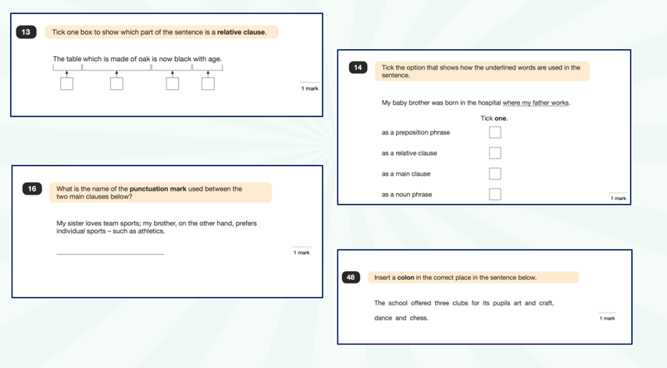
Spelling, Punctuation and Grammar: Paper 1
©Ks2history 2018

Slide 12
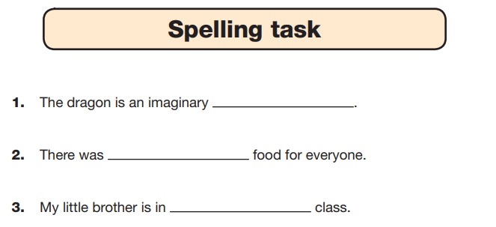
Spelling, Punctuation and Grammar: Paper 2
Paper 2 is a shorter paper that focuses solely on spellings.
Example questions:
©Ks2history 2018

Slide 13
The Reading Test
The test assesses whether pupils’ comprehension of age appropriate texts meets the national standard.
Pupils will have 60 minutes to complete the test, including reading the texts and writing the answers.
The test will have three different texts to read, drawing on fiction, non-fiction or poetry.
Questions are focused around the following areas (called ‘content domains’): - give/explain the meaning of words in context - retrieve and record information/identify key details from fiction and non-fiction - summarise main ideas from more than one paragraph - make inferences from the text/explain and justify inferences with evidence from the text - predict what might happen from details stated and implied - identify/explain how information/narrative content is related and contributes to meaning as a whole - identify/explain how meaning is enhanced through choice of words and phrases - make comparisons within the text
There are a range of answer types, including multiple choice, short one-word answers and longer answers that require a written paragraph.

Slide 14
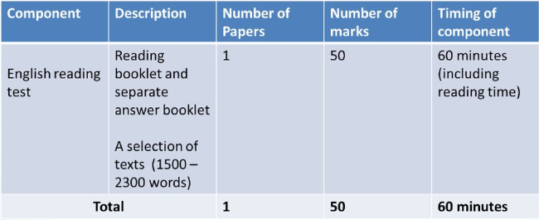
Reading
©Ks2history 2018

Slide 15
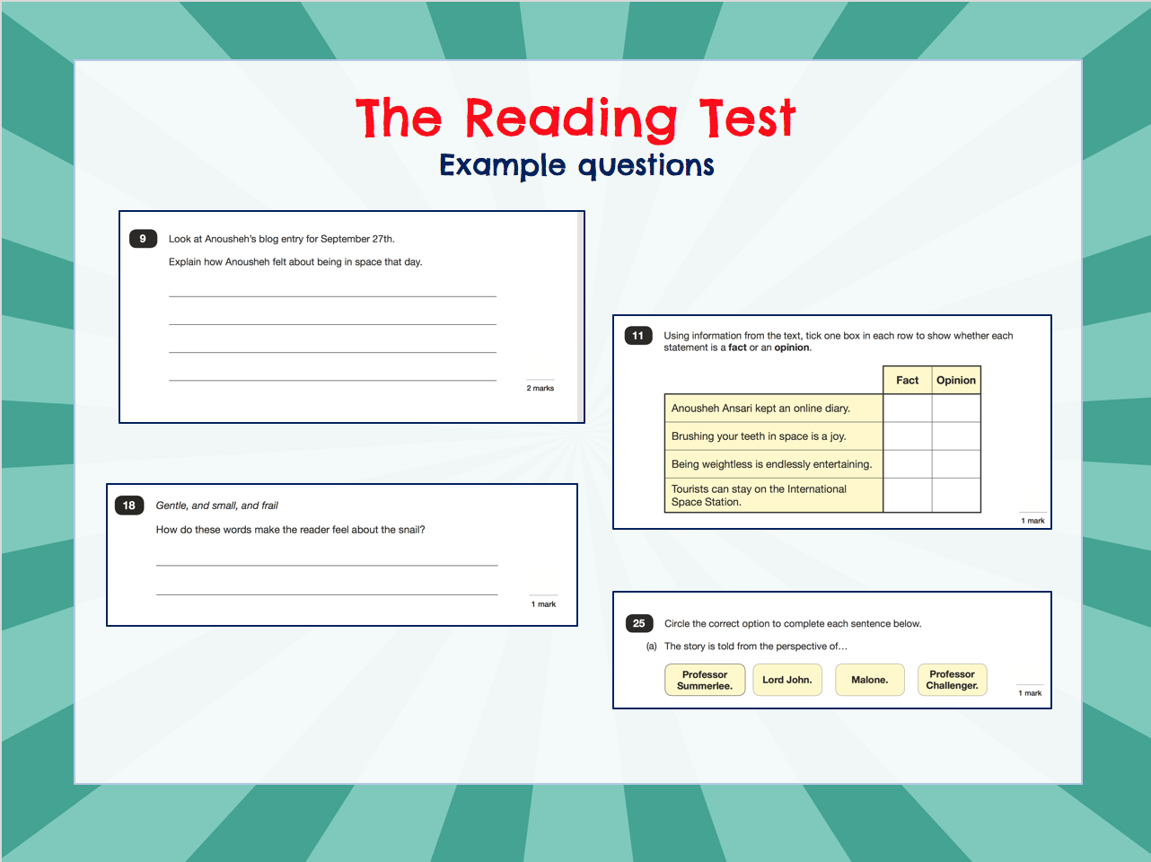
©Ks2history 2018

Slide 16
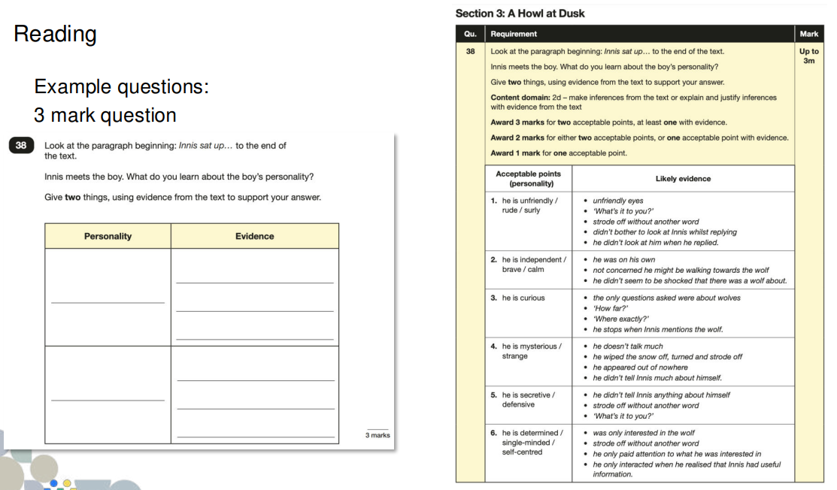
©Ks2history 2018

Slide 17
Maths
There are three tests: one arithmetic paper and two reasoning papers.
Paper 1 (arithmetic) lasts 30 minutes and assesses pupils’ confidence using methods of calculation as well as fractions, decimals and percentages. It covers curriculum content from all of KS2.
Papers 2 & 3 (reasoning) last 40 minutes each and focus on problem solving, and applying mathematical reasoning.
Questions cover the following areas: - Number and place value - Addition, subtraction, multiplication and division (calculations) - Geometry – properties of shapes - Geometry – position and direction - Statistics - Measurement - Algebra - Ratio and proportion - Fractions, decimals and percentages.
Questions increase in difficulty as the paper progresses

Slide 18
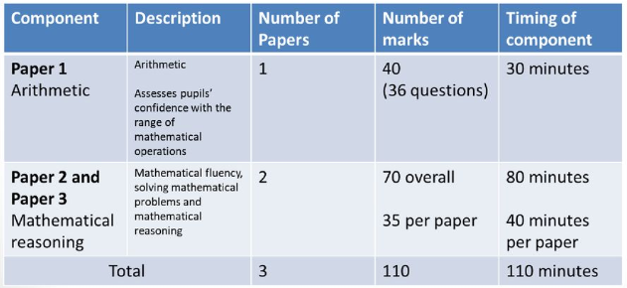
Maths
©Ks2history 2018

Slide 19
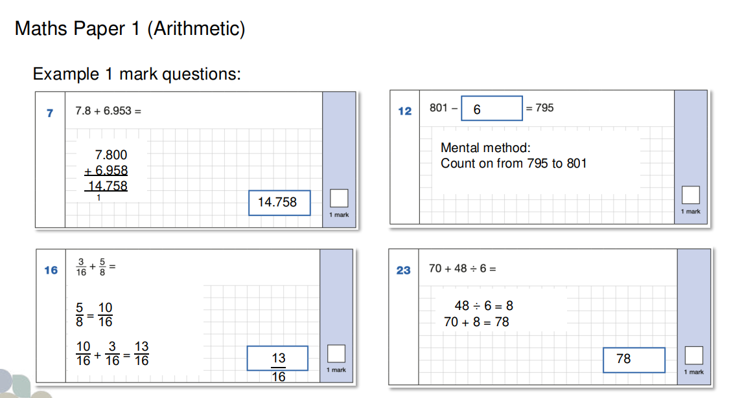

Slide 20
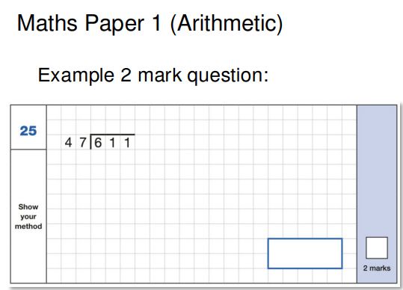
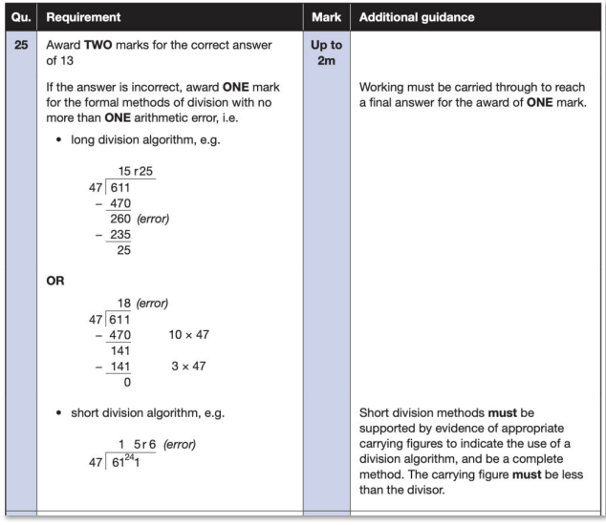

Slide 21
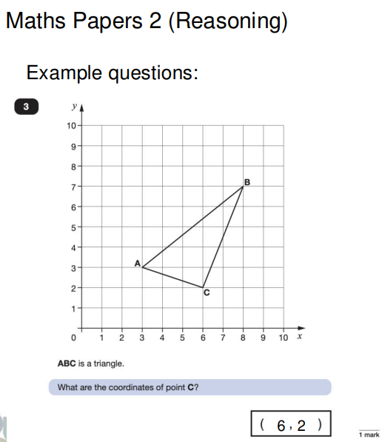
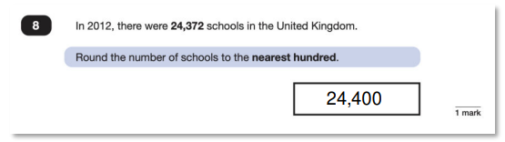

Slide 22
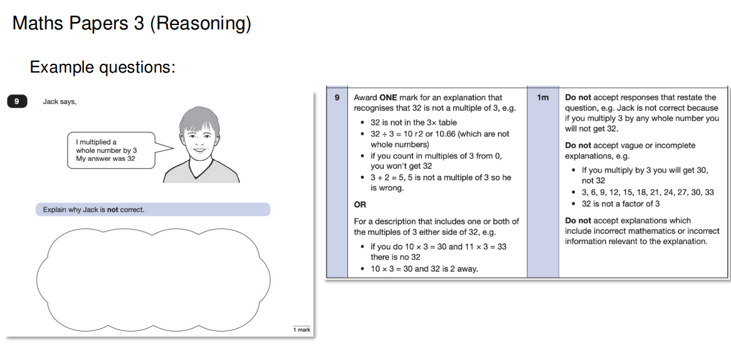

Slide 23
Writing
There is no writing SATS test.
Writing assessments will be formed from judgements made by the teacher, looking at evidence from writing collected over the course of the year.
The teacher will moderate their assessments with other professionals to make sure there is a consistent standard across the country.
Final judgements will be reported to parents at the same time as the other assessment results.

Slide 24
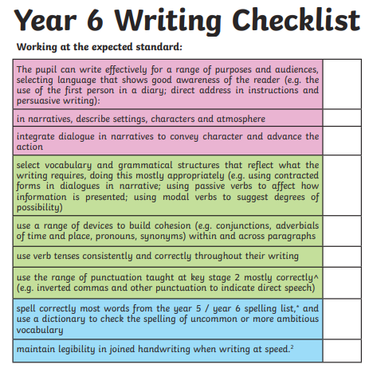

Slide 25
Writing exemplification materials
What does an expected piece of levels look like?

Slide 26
General support for preparing your child for the SATs
Firstly, a positive attitude goes a long way. Give them as much encouragement and support as you can (but we don’t need to tell you that)!
Tips:
Don’t use past papers as they are used in school to prepare the children.
Encourage your child to talk to their teacher or a trusted adult (including yourself) about their anxieties. Don’t forget that a small amount of anxiety is normal and not harmful.
Give your child a quiet, distraction free space to complete homework or study.
Give your child time to go outside and reduce screen time.
Ensure your child is eating and drinking well and getting a good amount of sleep.
Good attendance is vital
Plan something nice and fun for the weekends before and after SATs. This will help them to relax before the SATs and give them something to look forward to after.

Slide 27
How to help your child with Reading
Listening to your child read can take many forms.
First and foremost, focus developing an enjoyment and love of reading.
Enjoy stories together – reading stories to your child at KS1 and KS2 is equally as important as listening to your child read.
Read a little at a time but often, rather than rarely but for long periods of time!
Talk about the story before, during and afterwards – discuss the plot, the characters, their feelings and actions, how it makes you feel, predict what will happen and encourage your child to have their own opinions.
Look up definitions of words together – you could use a dictionary, the Internet or an app on a phone or tablet.
All reading is valuable – it doesn’t have to be just stories. Reading can involve anything: fiction, non-fiction, poetry, newspapers, magazines, football programmes and TV guides.

Slide 28
How to help your child with Writing
Practise and learn weekly spelling lists – make it fun!
Encourage opportunities for writing such as letters to family or friends, shopping lists, notes or reminders, stories and poems.
Write together – be a good role model for writing.
Encourage use of a dictionary to check spelling and a thesaurus to find synonyms and expand vocabulary.
Allow your child to use a computer for word processing which will allow for editing and correcting of errors without lots of crossing out.
Remember that good readers become good writers! Identify good writing features when reading (e.g. vocabulary, sentence structure and punctuation).
Show your appreciation: praise and encourage, even for small successes!

Slide 29
How to help your child with Maths
Play times tables games.
Play mental maths games, including counting in different amounts, forwards and backwards.
Encourage opportunities for telling the time.
Encourage opportunities for counting coins and money; finding amounts or calculating change when shopping.
Look for numbers on street signs, car registrations and anywhere else!
Look for examples of 2D and 3D shapes around the home.
Identify, weigh or measure quantities and amounts in the kitchen or in recipes.
Play games involving numbers or logic, such as dominoes, card games, darts, draughts and chess.

Slide 30
Helpful websites
IXL have separate pages of skills linked to individual Year group. The Y6 page has links to practise both English and Maths skills. Pages are then split into skills of which has a practise question for the children to think about.
https://uk.ixl.com/promo?partner=google&campaign=1187&adGroup=Key+Stage+2&gclid=CPPa8teS_8kCFQbnwgodgOIB6A
BBC Education have produced a whole host of materials for KS2. Follow the KS2 link and then select either Maths or English. Each area usually has an information section for reading, plus an activity and then quiz which is marked online. Some aspects require a subscription.
http://www.bbc.co.uk/education
A site with both Maths and English based quizzes which are marked as you go along.
http://www.educationquizzes.com/ks2/maths/
A site with a range of information and questions – great for revision purposes!
http://www.icteachers.co.uk/children/children_sats.htm
©Ks2history 2018

Slide 31
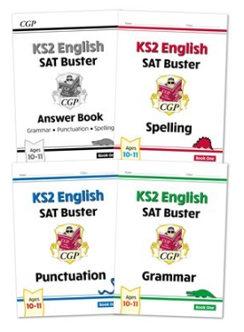
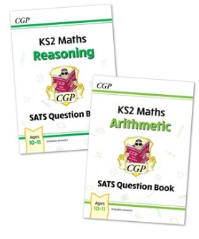

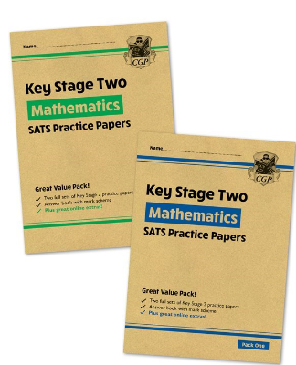
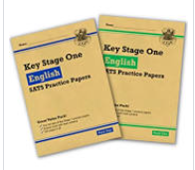
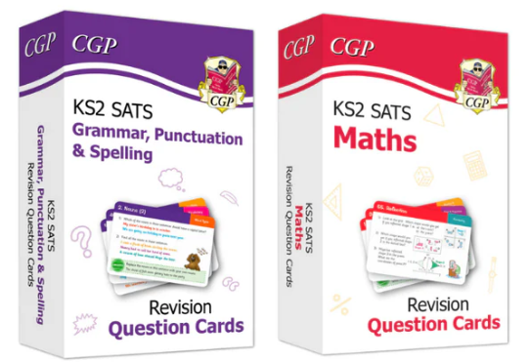
Booster materials
©Ks2history 2018

Slide 32

©Ks2history 2018

